Slide 1

HCI - Assignment n.2
Design and prototyping of an application using a human-centered approach
Final presentation and demo
Project Title: Personal Finance Management App
Group: Jodionísio Muachifi «97147», João Felisberto «98003» & Diogo Santos «98393»
Lab Class: P4
09-06-2022
HCI 2021-2022

Slide 2
Introduction
Personal Finance Management App
Personal finance is important for everyone and it was never easy to manage.
Specific to an individual’s situation and activity.
Help people that have little financial literacy manage their money
User-friendly personal finance management app
HCI 2021-2022
2
Notes:
These first slides are a recap of the first presentation and should be presented without much detail

Slide 3
Project Objectives
Personal Finance Management App
High-level goals
Develop an app that permits users to manage their finances in a simple way
Allow users to plan their budgets and savings.
Let users strongly control their daily expenses.
Expected outcomes
We aim for a semi-functional application with a minimalist and intuitive interface.
We achieved it as expected! (positive user rating in functional prototype evaluation)
HCI 2021-2022
3

Slide 4
Personas
Personal Finance Management App
The benefits
Provide an easy way for users to organize their budgets and savings for their goals.
Target Users
People that have little literacy on finance
People with poor money management
HCI 2021-2022
4

Slide 5

Persona 1
Personal Finance Management App
Persona | Scholarship holder
Name, Age, Gender | Ana Bela, 22 y/o, Female
Job | Student at Aveiro University
Background/Environment | She wants to control her daily expenses She wants to save money for her holiday voyage
Needs | She wants an app to help her easily manage her finances
HCI 2021-2022
5

Slide 6
Scenarios
Personal Finance Management App
Ana Bela orders a cup of coffee and wants to register the expense
Ana Bela's rent goes up, so she needs to readjust the budget
Ana Bela checks how much more money she needs to save for her summer vacation
Ana Bela creates a new saving for a computer
HCI 2021-2022
6

Slide 7
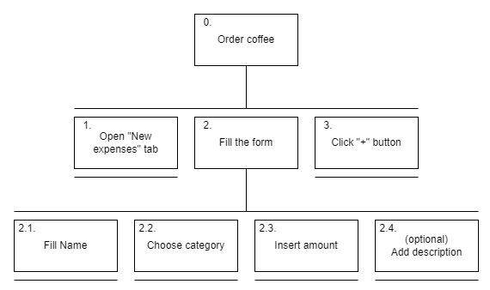
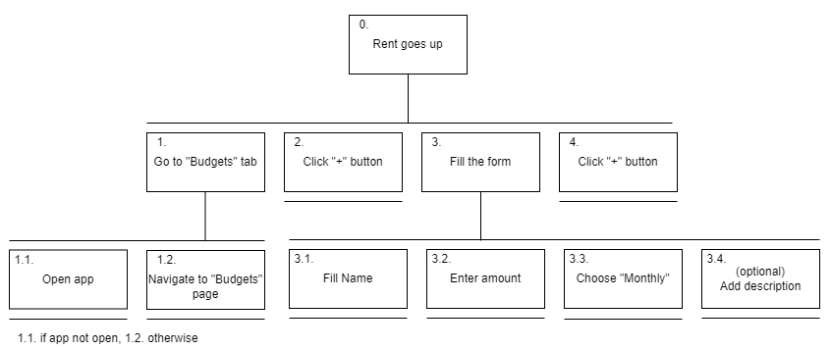
Tasks
Personal Finance Management App
Task 1: Order coffee
Task 2: Update budget when rent goes up
HCI 2021-2022
7

Slide 8
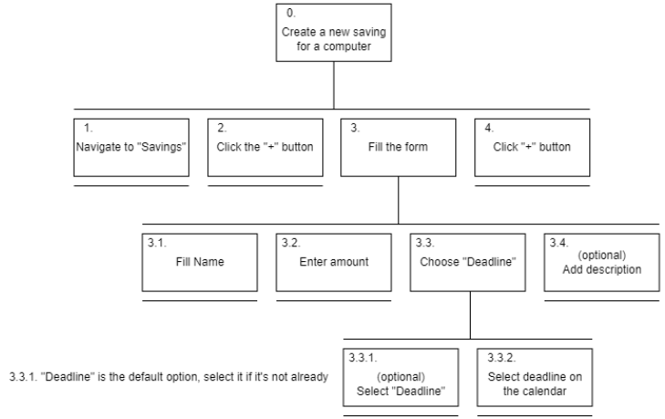
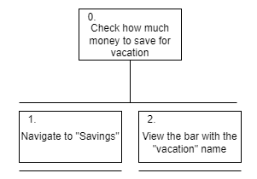
Tasks
Personal Finance Management App
Task 3: Check how much money to save for vacation
Task 4: Create a new saving for a computer
HCI 2021-2022
8

Slide 9
Requirements
Personal Finance Management App
Non-functional requirements
Should be easy and practical to use
Mobile
Persistent
Individual
HCI 2021-2022
9

Slide 10
Requirements
Personal Finance Management App
Functional Requirements
Register expenses associated with category
Create, modify and delete categories
Create, modify and delete saving goals
View expenses, budgets and goals
View how much money of each budget was spent
View how much money was already saved for each goal
Add money to a goal
HCI 2021-2022
10

Slide 11
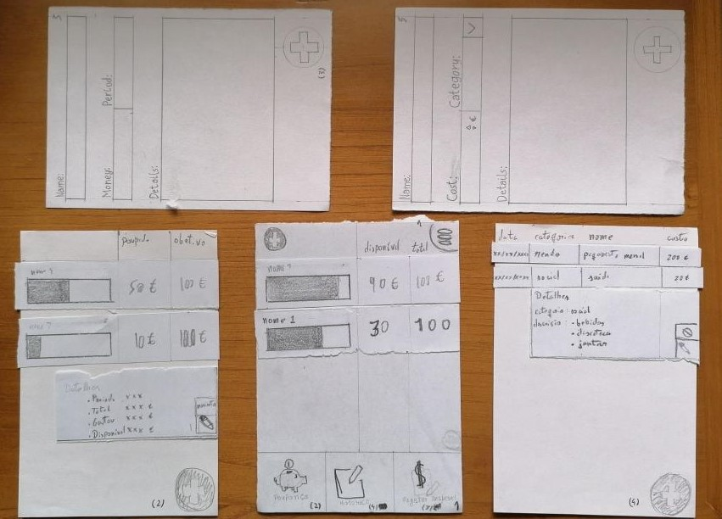
Low Fidelity Prototype (LFP)
Personal Finance Management App
The low fidelity prototype was
developed in paper
We tested it by having potential
users realizing tasks in our app: our classmates
We made 7 tests
HCI 2021-2022
11
Notes:
This is new material; should be presented in more detail

Slide 12
LFP User Evaluation
Personal Finance Management App
Usability test with paper prototype
3 tasks (registering an expense, observing a budget and editing a saving)
Users: classmates (7)
User feedback
Buttons on top to go back
Button to more quickly add a budget/expense
Pie chart and graphs for better visualization of historical data
Icons were not very explicit and lacked labels
HCI 2021-2022
12

Slide 13


Platform Used for the functional prototype
Personal Finance Management App
The main tool used was Android Studio
Chosen because it made more sense for this app
HCI 2021-2022
13

Slide 14
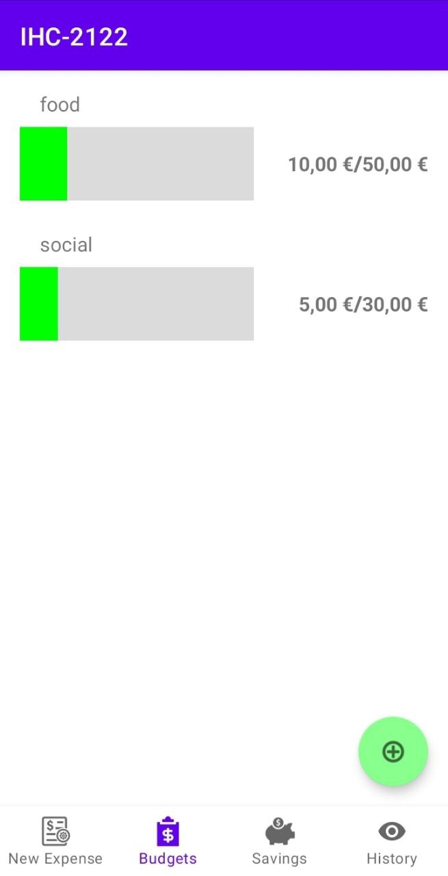
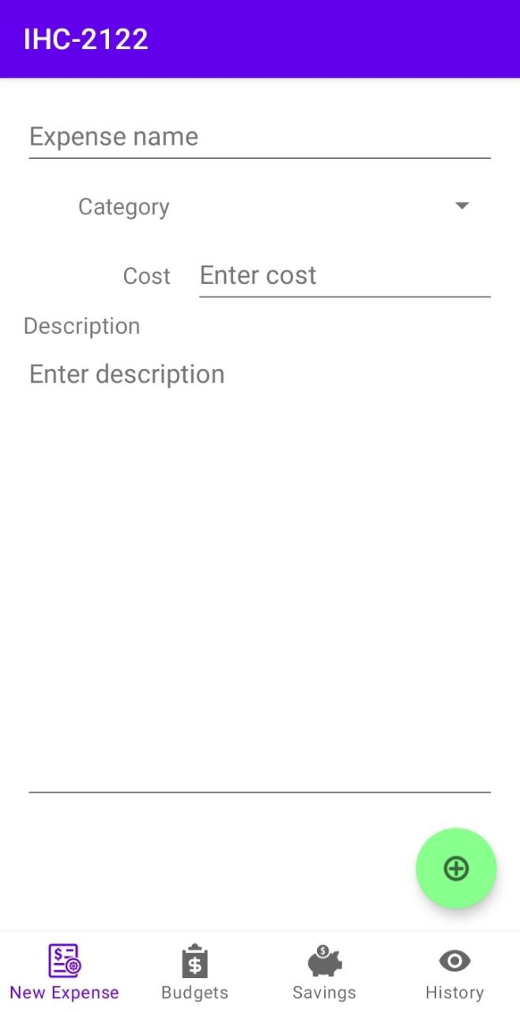
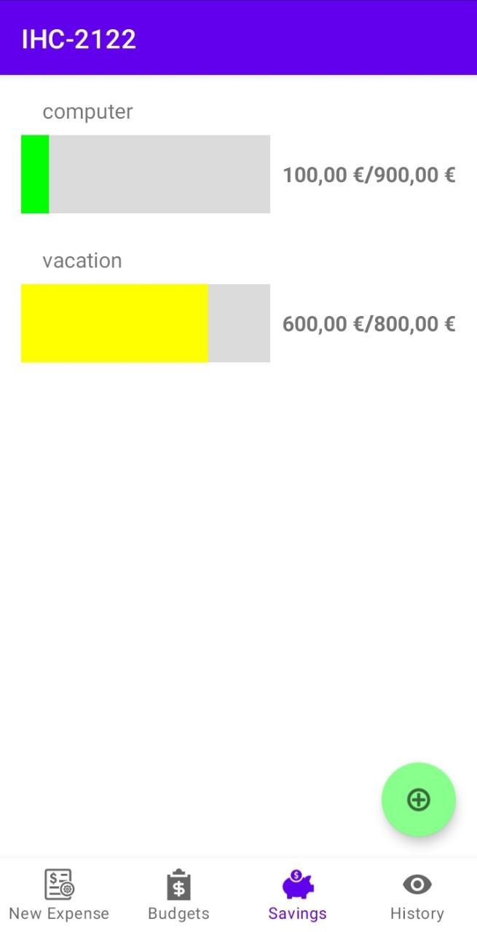
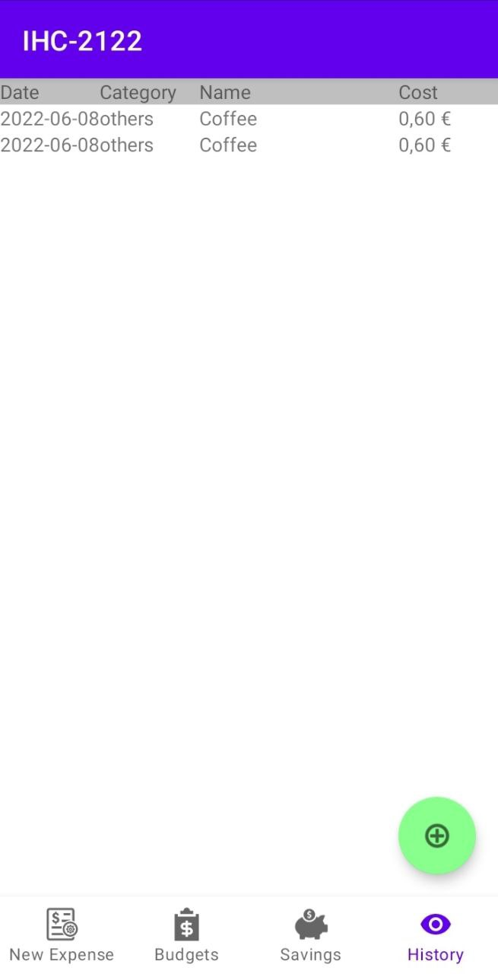
User Evaluation of the functional prototype
Usability test with prototype running in a mobile device
5 tasks (register expense, check budget, create budget for a service, view savings and edit savings)
Observer script/guide based on the ones used in a practical class, as well as post-task questionnaires (SUS)
Classmates, at least 1 of each practical group and class teacher
1 female, 5 males
20.4 years average (19-24)
2/5 had no experience with such apps, 1/5 had a lot of experience
HCI 2021-2022
14

Slide 15
User Evaluation of the functional prototype
Main results
Knowing where to navigate without labels proved difficult (Recognition rather than recall)
Some naming choices were not ideal (Consistency and standards)
HCI 2021-2022
15

Slide 16
User Evaluation of the functional prototype
task | lost | help | difficulty
Register a coffee purchase (0.60 €) | 0.43 | 0.14 | 4.57
Verify whether you can afford a 10€ meal | 0.57 | 0.29 | 3.57
Create a budget for streaming services of 20€ per month | 0.29 | 0.43 | 4.14
Check how much more money you need to save for your summer vacation | 0.43 | 0.29 | 4.29
Add 20€ towards your summer vacation fund | 0.43 | 0.29 | 3.29
Average of people who were lost and needed help on each task and their perceived difficulty (1 - hard, 5 - easy)
HCI 2021-2022
16

Slide 17
User Evaluation of the functional prototype
question | median grade
I think that I would like to use this system frequently. | 3
I found the system unnecessarily complex. | 4.5
I thought the system was easy to use. | 2
I think that I would need the support of a technical person to be able to use this system. | 3.5
I found the various functions in this system were well integrated. | 3
I thought there was too much inconsistency in this system. | 4
I would imagine that most people would learn to use this system very quickly. | 2.5
I found the system very cumbersome to use. | 3.5
I felt very confident using the system. | 2.5
I needed to learn a lot of things before I could get going with this system. | 5
Results of the SUS post task questionnaire (1 – strongly agree, 5 – strongly disagree)
The final SUS score is 68.75, greater than the reference value 68
HCI 2021-2022
17

Slide 18
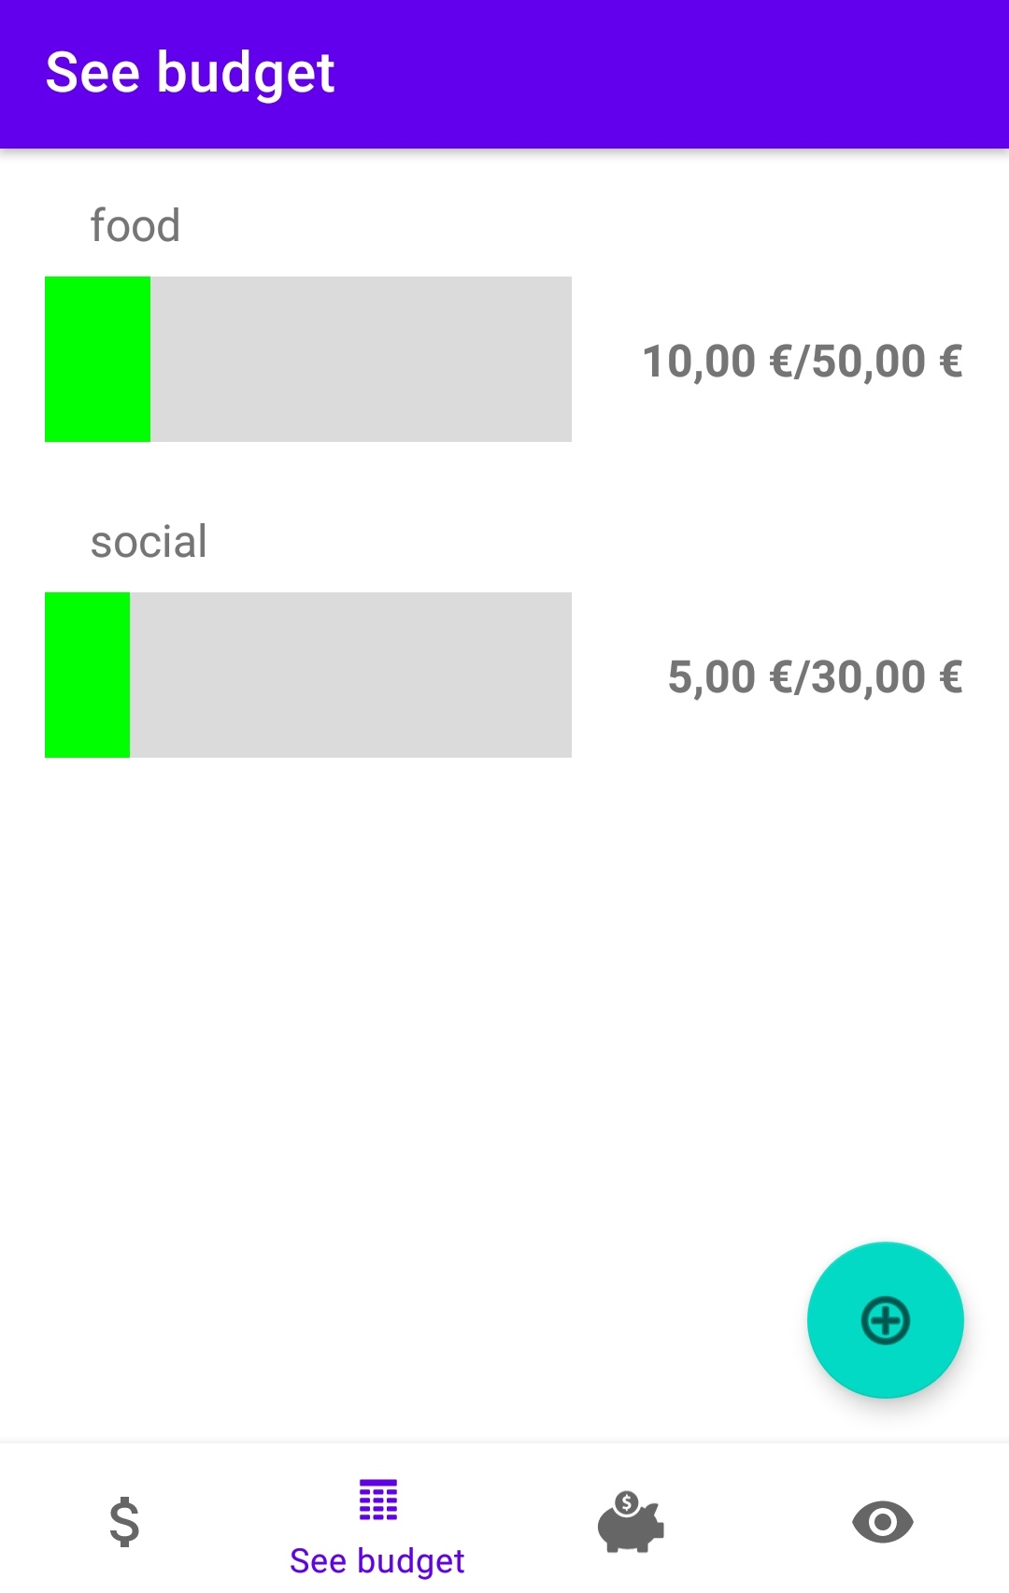
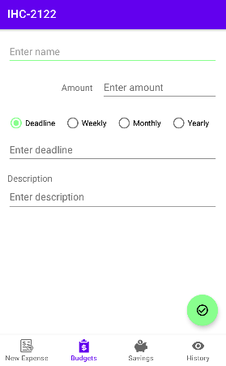
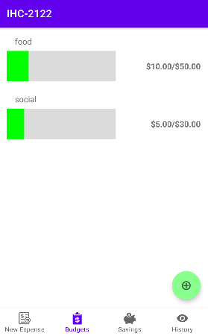
User Evaluation of the functional prototype
Changes made
"Budgets" and "New expenses" have updated icons
Labels changed on the bottom and now always showing
"Add" button color changed to light green
"Deadline" instead of "Date"
Added Weekly, monthly and yearly budgets/savings
"Check" icon when editing something
Fixed navigation between pages
HCI 2021-2022
18

Slide 19
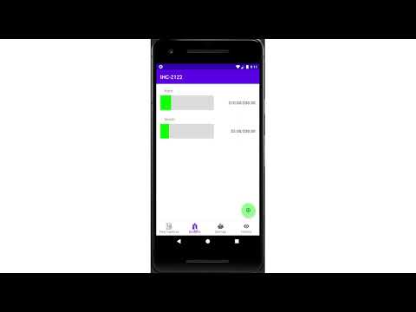
Demo
Personal Finance Management App
Small demo of the execution of the 5 tasks
HCI 2021-2022
19

Slide 20
Future work
Maybe improve frontend based on user feedback
Add new functionalities like backup
Fix persistency in the application
Effort of each group member
Jodionísio Muachifi – 33%
Diogo Santos – 33%
João Felisberto – 33%
HCI 2021-2022
20

Slide 21
Acknowledgments
To all people that participated on the two tests of our low fidelity prototype and of the functional prototype
Bibliography
Cooper, A., R. Reimann, and D. Cronin, About Face 3 The Essentials of Interaction Design. Wiley Publishing, Inc., 2007
HCI 2021-2022
21

